Slide 1
Evaporation

Slide 2
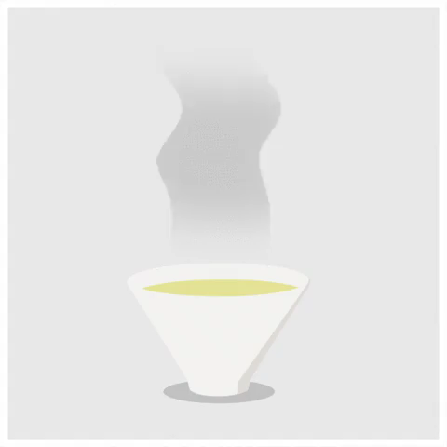
By the end of this lesson you should be able to:
1. | Explain what happens to water if you leave it out in the sun.
2. | Describe how we use this process to separate a solution in the lab.

Slide 3
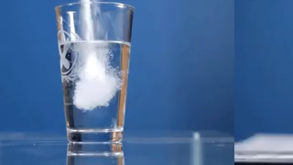
By now, you should be familiar with the techniques used to separate suspensions.
It is relatively easy to separate suspensions because their particles are large.
Separating a solution is harder because the particles are dissolved into a solution. Solute particles are tiny and cannot be removed physically.

Slide 4
One method that we can use to separate solutions is evaporation.
When liquids are heated, they turn into gases. Water, for example, turns into water vapour when it gets hot.
This process is called evaporation.

Slide 5
You can see this when you leave a glass of water in the sun.
The amount of water in the glass decreases as it turns into gas and floats away.
This is because the heat of the sun is turning the liquid into gas.

Slide 6
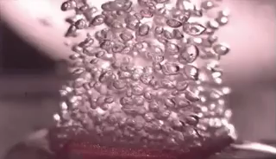
Every liquid has a boiling point - a temperature where it becomes a gas.
Every substance has a different boiling point.
Therefore, the solute and solvent have different boiling points. This means that, as a solution heats up, one will reach the boiling point first.

Slide 7
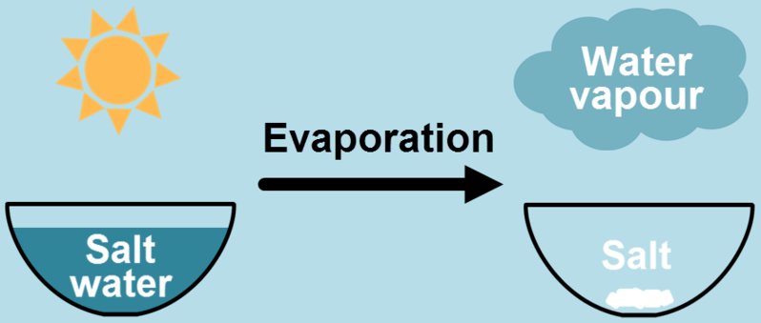
We can use evaporation to remove the solvent from a solution and keep the solute.
Usually, solute particles have high boiling points, and will not turn into gas with the solvent.

Slide 8
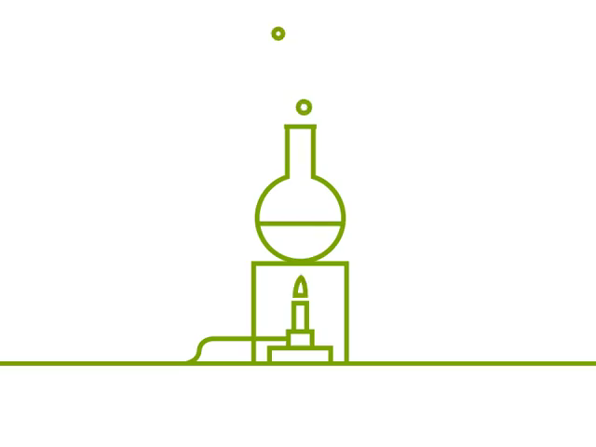
Therefore, by evaporating the solution, we remove the solvent and leave the solute behind.
Heating a solution with a Bunsen burner can speed up this process.

Slide 9
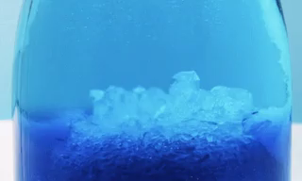
As a solution evaporates, it becomes saturated.
Saturated solutions are full of solute - no more can dissolve into the liquid solvent.
If a saturated solution is evaporated, there will now be too much solute. So what does it do? It solidifies out of the solution.

Slide 10
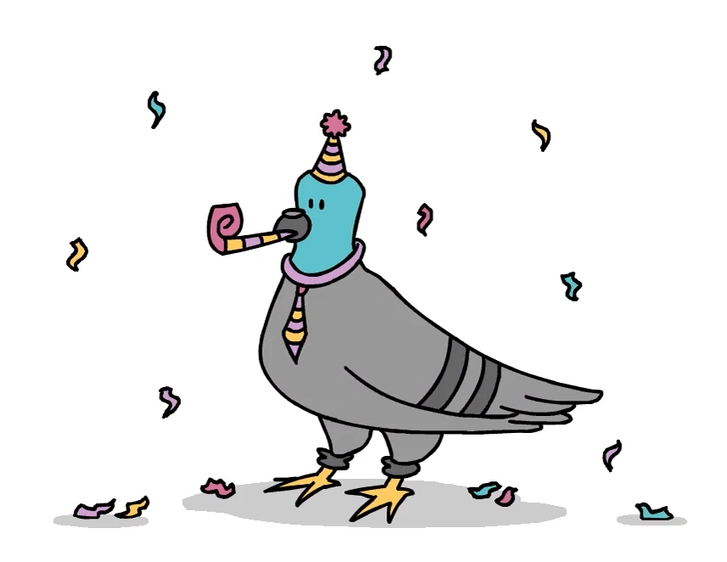
To recap: when a solution is heated, the solution loses solvent as it heats up.
The solution becomes saturated and a solid starts to form. Eventually all of the solvent boils away, leaving behind a dry solute.
The mixture has successfully been separated!

